Slide 1
SMART FASHION RECOMMENDER APPLICATION
Team id: PNT2022TMID23067
Team Members:
K.R.Sree Aakash
R.S.Yoha Venkatesh
S.Saravanan
B.Buvisuriya
Project Mentor:
Mr K.Azarudeen B.E,M.E.

Slide 2
Problem Definition:
We have come up with a new innovative solution through which you can directly do your online shopping based on your choice without any search. It can be done by using the chatbot.
In this project you will be working on two modules :
1. Admin
2. User

Slide 3
MODULES USED:
Admin:
The role of the admin is to check out the database about the stock and have a track of all the things that the users are purchasing.
User :
The user will login into the website and go through the products available on the website.
Instead of navigating to several screens for booking products online, the user can directly talk to Chatbot regarding the products.
Get the recommendations based on information provided by the user.

Slide 4
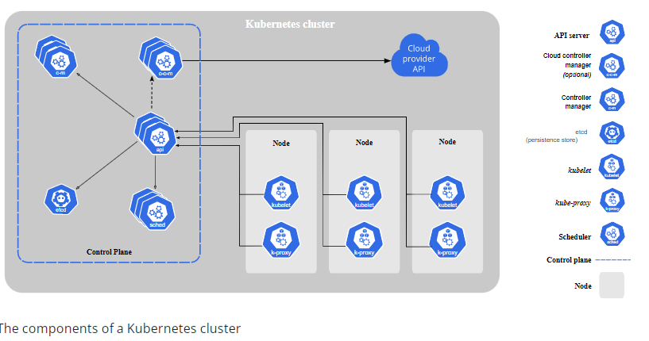
Technology Used:
Kubernetes Components
When you deploy Kubernetes, you get a cluster.
A Kubernetes cluster consists of a set of worker machines, called nodes, that run containerized applications. Every cluster has at least one worker node.
The worker node(s) host the Pods that are the components of the application workload. The control plane manages the worker nodes and the Pods in the cluster. In production environments, the control plane usually runs across multiple computers and a cluster usually runs multiple nodes, providing fault-tolerance and high availability.
This document outlines the various components you need to have for a complete and working Kubernetes cluster.

Slide 5
Kubernetes Control Plane
The control plane is the nerve center that houses Kubernetes cluster architecture components that control the cluster. It also maintains a data record of the configuration and state of all of the cluster’s Kubernetes objects.
Kubernetes Cluster Architecture
Managed by the control plane, cluster nodes are machines that run containers. Each node runs an agent for communicating with the control plane, the kubelet—the primary Kubernetes controller. Each node also runs a container runtime engine, such as Docker or rkt.
A pod represents a single instance of an application, and the simplest unit within the Kubernetes object model. However, pods are central and crucial to Kubernetes. Each pod is composed of a container or tightly coupled containers in a series that logically go together, along with rules that control how the containers run.

Slide 6
SURVEY PAPERS:
1)
Author Name:B. Erdebilli
Title:Development of an E-Commerce Chatbot for a University Shopping Mall
Publication website:
Published Date:20 March 2021
Objective:
This work attempts to overcome this ongoing challenge by creating a chatbot for Shopping Mall. The chatbot’s purpose is to have a smart, accurate, and real-time conversation with the students.
In this way, users can chat with the bot to inquire about particular items they seek to purchase and pay online for the items before visiting the mall.
The chatbot will be accessible via portable mobile devices or computers, which students can log in to anywhere and anytime on campus, thereby providing a 24-hour online service.

Slide 7
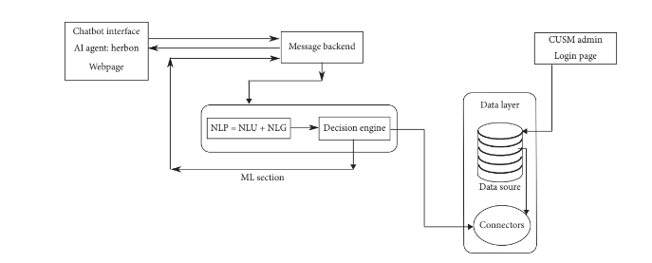
WORKING:
chatbot is an automated AI software program that allows for human-bot interaction. These conversations can be implemented through text interfaces and voice interfaces.
Besides, chatbots are embedded AI features that accompany websites and messenger applications and, in some instances, serve as standalone bots.
ARCHITECTURE:

Slide 8
2)
Author Name:M.Mamatha, C.Sudha
Title:Chatbot for E-Commerce Assistance: based on RASA
Publication website:Turkish Journal of Computer and Mathematics Education
Published Date:10 May 2021
OBJECTIVE:
Whenever a customer using an Ecommerce sites like Amazon, Flipkart etc, he may face issues which may trouble him. It takes time for the customer support to resolve the customer issues since billions of people are using those platforms and reporting issues regularly.
This bot will be useful for filtering the products from whatever the ecommerce sites it has been incorporated it with here the own site developed, which runs in local server as other ecommerce
api procurement is taking much time than expected and also replying to some of the issues before they get to the customer call center.

Slide 9
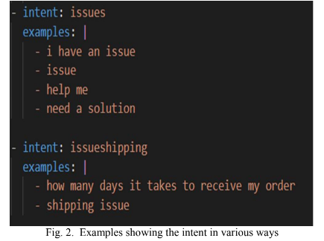
PROPOSED MODEL:
Rasa Modules
A raw chatbot build on top of deep learning and machine learning techniques basically uses any of the
frameworks like tensor flow etc. They need to be modeled from scratch.
But using Rasa we simply use the modules provided by rasa to train the inbuild model with the input data where the intent from the user can be get and also customizing the output for the user intent.
Snapshot of rasa

Slide 10
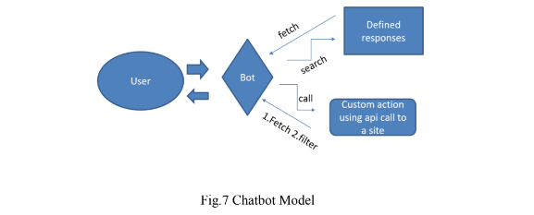
Chatbot System Architecture:
Now using the respective modules we have discussed above are used to build the chatbot which has the above structure represented. Here User may interact with the Chatbot in any of the two forms namely command line and he user interface.
Whenever a user type something and press enter, the message or the input will be taken by the
bot and the user intent is drawn from the input text.
Based on the intent Bot will decide whether the result for the input query is required any external api call.
The results thus obtained are given to the user through the same interface(command line) or graphical user interface

Slide 11
3.
Author:A. R. D. B. Landim, A. M. Pereira,
Title: Chatbot design approaches for fashion E- commerce: an interdisciplinary review
Publication website: https://www.tandfonline.com/loi/tfdt20
Published Date:02 Nov 2021
Literature Review:
A first distinction of chatbots studies is along the lines of computational aspects (i.e. aspects related to the area of Computer Science or Information Technologies, such as the use of NLP) and non-computational aspects (i.e. all other aspects such as studying consumer acceptance).
Most research on chatbot computational aspects had English as their primary language (76.3%), followed by papers on Indonesian chatbots (6.8%) and other languages like Chinese and Bangla.
It is also worth mentioning that, while non-computational research mainly employed a diversity of ready-to-use chatbot tools like Amazon Alexa, computational papers usually focus on chatbot development using a specific programming language.

Slide 12
4.
Author:Jhonny Cerezo, Juraj Kubelka,Romain Robbes
Title:Building an Expert Recommender Chatbot
Publication website: https://www.researchgate.net/publication/335645153
Published Date:May 2019
Literature Review:
Software bots. Leboeuf developed a taxonomy of software bots Følstad and Brandtzæg argue that HCI may transition from graphical to conversational interfaces via chatbots
They also conducted a survey of chatbot users, finding that the most common reason, by far, was productivity (68%)
Pharo. Pharo is an open source programming language, with a strong community concentrated in Discord (a chat platform service) and a mailing list.
The chatbot identifies source code artifact names (key-concepts) in user messages, e.g., in “Who is GLMAction class expert?”, the key-concept is “GLMAction”.
Inverse document frequency (IDF) algorithm
IDF(t, D) = log |D| /1 + TF(t, D)
where t is a user message word, D is the IDF-dataset, and TF(t, D) is term frequency algorithm computing number of term t occurrences in D.

Slide 13
IDF is a numerical statistical method reflecting how important a term (word) is in a user message . The algorithm uses an IDF-dataset (D) that includes all questions that we extracted from the Pharo Discord chat channels.
Sentence Classification:
The first step towards recognizing user conversational intentions is categorizing user messages. The chatbot classifies
sentences in the following empirically defined message categories:
Greeting: Includes greeting and introductory messages,
e.g., “How are you doing?”
Package expert: Includes questions explicitly asking for package experts
e.g., “Who is Iceberg package expert?”
Class expert: Includes questions explicitly asking for class experts.
e.g., “Who is GLMAction class expert?”
Method expert: Includes questions explicitly asking for method experts.
e.g., “Who is method Object yourself expert?”
Informative: Includes questions supported by the chatbot, not fitting into the above mentioned categories.
e.g., “What can I ask you for?”
Unrecognized message: Includes user messages not supported by the chatbot.
e.g., “Ok”

Slide 14
5.
Author:Amir-reza Asadi, Reza Hemadi
Title:Design and implementation of a chatbot for e-commerce
Publication website: ICTD(Information Communication Technology and Doing Business)
Published Date: 2018
Literature Review:
This research is following the usage of conversational interaction for existing online stores
whether they sell goods or services.
Since WooCommerce is the most popular solution technology for e-Commerce and 43% of the entire of internet is using it we have implemented the project based on WooCoomerce.
Telegram is the most popular messenger in Iran the bot is implemented based on the Telegram API but the purposed design can also be implemented in a pop up window of internet browser or Facebook
messenger with a few modification.

Slide 15
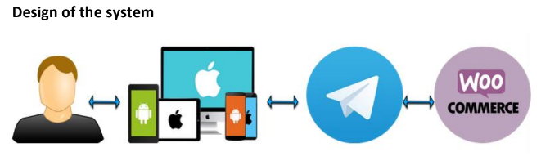
Related Works:
Chatterbots are not new programs in the computer world and ELIZA, the first chatter bot was
released in 1966 by but most of the existing chatbots are mainly for recreational and
research purposes .
Most notable chatbots that were designed with the purpose of
conversational commerce were released by the banking sector, for example DBS bank of
Singapore has created its own virtual assistant which is called DigiBank.
chatterbot is integrated with their website which is coded in PHP and has a MYSQL database. To make the chatterbot intelligent they used RiverScript.
Architecture:

Slide 16
6.
Author:Siddharth Gupta,Deep Borkar
Title:An Ecommerce Website Chatbot
Publication website: International Journal of Computer Science and Information Technologies
Published Date: 2015
Literature Review:
A user visiting an E-commerce may look for a specific product, or generally browse the website. The search tools use keyword matching to display multiple results to the user’s query
The search tools fail to deliver relevant results when ambiguous and imprecise words is used to describe a product.
The chatbot attempts to address the above mentioned issues by presenting a more intuitive way of interacting with the website. It interacts with you and also suggests products suitable for you.
This project takes the FAQ chat approach, where instead of using a complex Natural Language Processing System and logical inference, a simple but large set of pattern matching templates will suffice

Slide 17
7.
Author:Maria D. Illescas-Manzano , Noe Vicente Lopez
Title:Implementation of Chatbot in Online Commerce, and Open Innovation
Publication Website:Journal of Open Innovation
Published Date:May 2021
Literature Review:
Chatbots are conversation engines that interact in real time with customers, machine operators, maintenance workers, etc. In addition, they can offer advanced dialogue and technology conversations using machine learning (ML) and artificial intelligence (AI) enhancements
Different types of chatbot:
Based on rules.
Smart. This chatbot is based on artificial intelligence, by which it collects information through conversations with customers.
Hybrid. This is a mixture of the two previous types, combining rules and artificial intelligence

Slide 18
Objectives:
Analyze the usability of the platform to generate leads (implementation, use, data processing, and effectiveness in established conversations).
Design and implement a chatbot for the e-commerce of a company.
Evaluate the results of implementation.
Uses:
In the field of health, due to the coronavirus disease 2019 (COVID-19) situation, in Germany a chatbot was designed to provide information related to preventing the disease and detecting possible symptoms.
American Eagle Outfitters, in the field of fashion, and Domino’s Pizza [33], in the field of restaurants, have launched chatbots to collect orders and make product suggestions
In Italy, a voice chatbot is being designed to determine the intensity of the disease, and all of the collected information is stored until a doctor can be seen
Limitations:
During the preparation of this work, Facebook changed its restrictions on the use of its Messenger application API, which represents an important limitation to this work.
The restrictions arose from the platform’s attempt to comply with the privacy laws published by the European Economic Area (EEA)

Slide 19
8.
Author:Anusha Vegesna, Pranjal Jain, Dhruv Porwal
Title: Ontology based Chatbot
Publication Website: International Journal of Computer Applications
Publication Date: January 2018
Proposed System:
The proposed system is an Ontology based chat-bot which will be mainly based on the E-commerce domain.
Ecommerce website APIs (EBay website which is freely available) are used as the data source.
Ontology template is built using PROTEGE platform that retrieves data from the data source (using Jape rules).
Ontology follows java object oriented approach, such as inheritance to avoid redundancy that prevails in the existing systems
Modules Used:
Knowledge base (KB)
Ontology Template
Dialog Manager

Slide 20
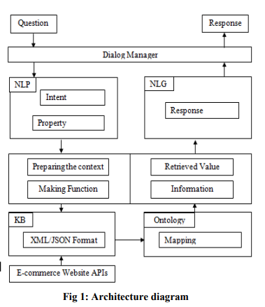
Architecture Diagram:

Slide 21
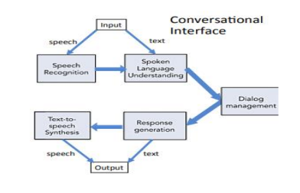
Critical Findings:
Implementation Approaches to Chatbots:
It comprises of four parts first is front-end second is knowledge-base third is back-end and corpus which are training data.
The communication with the user is done on front end part. NLU (natural language understanding) is used to understand the context and intent of the user input.
The back-end produces the knowledge base by making use of the domains corpus. Input is given to the chatbot in the form of speech or text.

Slide 22
Intelligent Chatbot for Easy Web-Analytics Insights:
The chatbot is built using Artificial Intelligence Markup Language contain analytics' raw data and the required data is fetched from the analytics tool’s raw data.
Every website note all the details user made. AIML comprises of possible queries and their responses
There are 3 query scenarios that can be considered
1: Domain Related Query Scenario
2: General Queries Scenario
3: None of the above

Slide 23
De-Merits:
Certain chatbots have limited availability of data and require some time for their self update. This process leads to slower response times and expensive solutions.
Chatbots are poor in making decisions unlike human beings.
Chatbots have limited responses, so they're not often able to answer multi-part questions or questions that require decisions. This often means your customers are left without a solution, and have to go through more steps to contact your support team.

Slide 24
Software and Hardware Requirements:
Software Required:
Python, Flask , Docker
System Required:
8GB RAM,Intel Core i3,OS-Windows/Linux/MAC ,Laptop or Desktop

Slide 25
THANK YOU

